Slide 1
Fish 559 - Fall 2020
Numerical Computing for Fisheries Assessment and Management

Slide 2
Basic Information
Instructor:
  Andre Punt (FISH 116; aepunt@u)
Class web-site
  http://courses.washington.edu/fish507/index.htm
Prerequisites for this course
  Fish 458, some programming experience (or talk to me)

Slide 3
Class Structure
The ADMB Workshop
Lectures: F (11.30-12:20)
Computer laboratory sessions: M, W (11:30-13:20)
Grading
  Assignments in the workshop (20%)
  Four homework assignments (40%).
  Project (40%).

Slide 4
The Web-site
The powerpoint slides for each lecture will be posted the day before the lecture concerned.
Homeworks:
  Solutions will be posted the day after all homeworks have been submitted.
  Discussion of questions among students is encouraged; cheating is not.
The ‘Readings and Resources’ page includes useful links – if there are any other links you find useful, let me know and I will update the resources page.

Slide 5
Course Overview
Four focus areas:
  how to use R to perform numerical analyses;
  how to use Template Model Builder to fit models to data;
  standard numerical techniques.
The lecture topics are available on the web-site.

Slide 6
Mixed Effects Modeling-I
Fish 559; Lecture 1
Notes:
a

Slide 7
What are Fixed and Random Effects?
Fixed Effects:
  Parameters associated with the entire population or with certain repeatable levels of experimental units.
    The value for the vessel factor for the SS Titantic.
Random Effects:
  Parameters associated with individual experimental units drawn at random from a population.
    The value of the vessel factor for the 23rd vessel in a database.

Slide 8
Mixed Effects Models
A mixed effects model is a model that has both fixed effects and random effects.
Often the same random effect is assigned to observations sharing a common classification factor:
  Consider length-at-age data for several (randomly selected) stocks of a species. The random factor is stock and the observations are length-at-age data.
  Random effects can the thought of as ways of modelling the covariance structure of the data.

Slide 9
Estimation Techniques
Classical (frequentist) and Bayesian methods can be used to estimate the parameters of mixed effects models.
Lectures 1 and 4 focus on the use of frequentist methods. We covered Bayesian mixed effects models during the TMB workshop.

Slide 10
Linear Mixed Effects Models
Vector of fixed effects
Observations for group i
Vector of random effects
The traditional linear modeling framework is a special case of
of this model in which there are no random effects.

Slide 11
A Simple Example
(sensu Pinherio and Bates, Chapter 1)
We select six streams at random and determine the density at each stream three times.
The questions:
  What is the density in a typical stream?
  What is the variation in density among streams?
  What is the variation in density estimates within a stream?

Slide 12
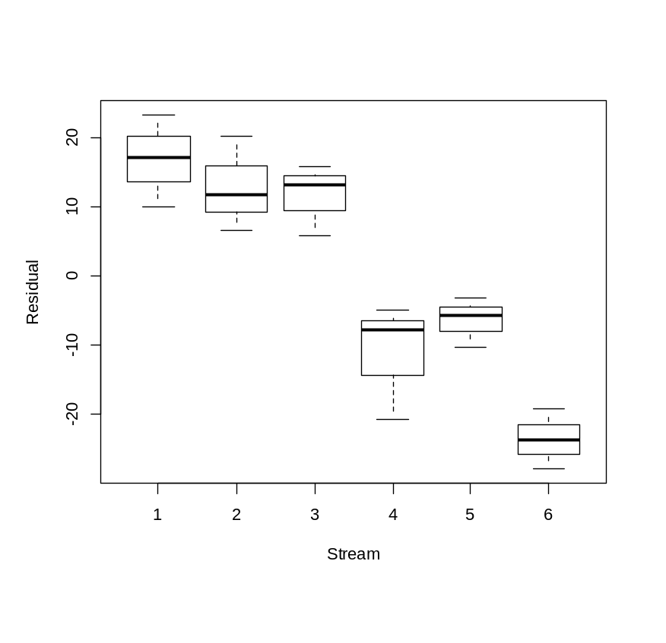
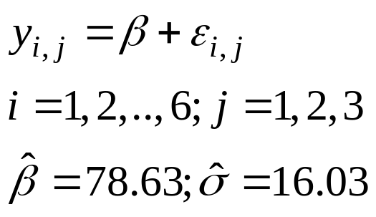
Fit of the Standard Linear Model
This analysis attributed all the error to within-stream variation. However, it is clear that there is between-stream variation in density but we have no way to comment on it.

Slide 13
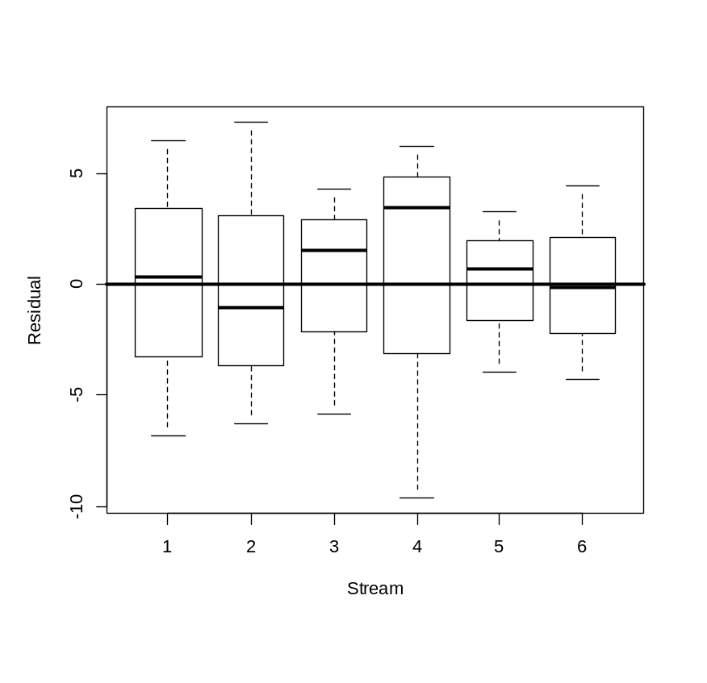
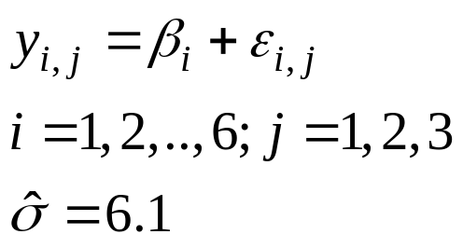
The Next Step: Fit a Model with a “Stream-Effect”
The residual pattern has been removed, but we have no overall mean and no way to comment on between-stream variance, i.e. we cannot say anything about the population of streams.

Slide 14
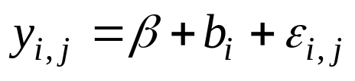
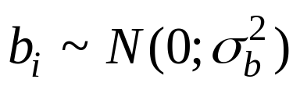
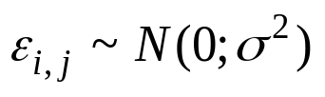
Finally: A Mixed Effects Model
We construct a random effects model as follows:
β is the mean density across the population,
b_{i} is a random variable representing the deviation from the population mean:
ε_{i,j} is a random variable representing the deviation for observation j from mean density for stream i, i.e.

Slide 15
Finally: A Mixed Effects Model
(Some notes-I)
The residuals are assumed to be independent, normally distributed random variables with constant variance.
The random effects are assumed to be normally distributed.
This only works if the streams have been selected at random from the population of streams.
Mixed effects models are also called hierarchical models.
The number of parameters in this model is three (β, σ and σ_{b}) because stream is just another level of random variation (we never count the residuals as parameters).

Slide 16
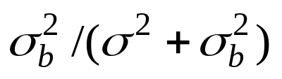
Finally: A Mixed Effects Model
(Some notes-II)
The model we have is a one-way linear classification model.
Introducing random effects can be thought of (in this case) as allowing for correlation of among the density estimates for a given stream.
There are ways to estimate the random effects (we will often be interested in their values).

Slide 17

Finally: A Mixed Effects Model
The results from fitting the mixed effects model are:
These estimate are similar to the linear model with separate “stream effects” (but would not be if this was an unbalanced design).

Slide 18
Time for some R
(first create a data framework)
FileN <- “LEC1A.TXT"
TheData <- scan(FileN,what=list(Stream=0,NULL,Density=0),n=3*18)
Streams <- data.frame(TheData)

Slide 19
Time for some R-II
The call to LME first gives the fixed effects (the intercept in this case), followed by the data set, and finally the random component of the model.
Fitting the fixed effects models:
  lm1 <- lm(Density~1,data=Streams)
  lm2 <- lm(Density~factor(Stream)-1,data=Streams)
Fitting the mixed effects model:
  lm3 <- lme(Density ~ 1,data=Streams, random = ~ 1 | Stream)

Slide 20
The LME Function
The full call is:
lme(fixed, data, random, correlation, weights, subset, method, na.action, control)
fixed – formula for the fixed effects;
data – must be a data frame;
random – the random effects (random effects can be nested);
correlation – correlation structure of the residuals (optional);
weights – variance structure of the residuals (optional);
subset – which rows of the data set to include (vector of boolean)
method – ML or REML
control – optional control specifications (some of these are pretty useful).

Slide 21
Linear Mixed Models (Notes)
The linear mixed model can be fitted using Maximum Likelihood (ML) or Restricted Maximum Likelihood (REML). If you have many experimental units, this hardly matters, but if you have few replicates, this can make a major difference (I always use REML).

Slide 22
Linear Mixed Models
(Understanding the output)
AIC and BIC
for model selection
Linear mixed-effects model fit by REML
Data: Streams
AIC BIC logLik
133.7973 136.2969 -63.89865
Random effects:
Formula: ~ 1 | Stream
(Intercept) Residual
StdDev: 15.78877 6.083881
Fixed effects: Density ~ 1
Value Std.Error DF t-value p-value
(Intercept) 78.62872 6.60332 12 11.90745 0
Standardized Within-Group Residuals:
Min Q1 Med Q3 Max
-1.670431 -0.8239512 0.1256738 0.5295573 1.298799
Number of Observations: 18
Number of Groups: 6
The among-stream SD
The within-stream SD
The fixed effects

Slide 23
Fixed and Random Effects Together
Often, we will have cases in which there are some known sources of variability (the random effects) and some factors which may have different impacts.
These models will have both fixed and random effects.

Slide 24
Model selection with fixed and random effects (Zuur et al)
Set the fixed effects based on “as many explanatory variables as possible”.
Select a random effects structure using AIC (using REML).
Fix the random effects structure and compare fixed effects options (using ML estimation). [Likelihood tests do not work with REML]
Compute the final model using REML.

Slide 25
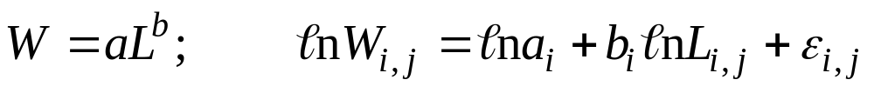
Fixed and Random Effects Together
(Length-weight regressions)
The Problem:
  We select 10 individuals and measure the relationships between their lengths and weights as they grow. The relationship between length and weight is:
  We are interested in whether b differs among individuals (a is individual-specific and individuals were selected randomly)
  The formulae:
    TheData <- scan(“LEC1B.TXT",what=list(Subject=0,TST1=0,TST2=0,Length=0,Weight=0,TST3=0),n=6*100)
    LenW <- data.frame(TheData)
    lm1 <- lme(Weight~Length,data=LenW,random = ~1 |Subject,method="REML")

Slide 26
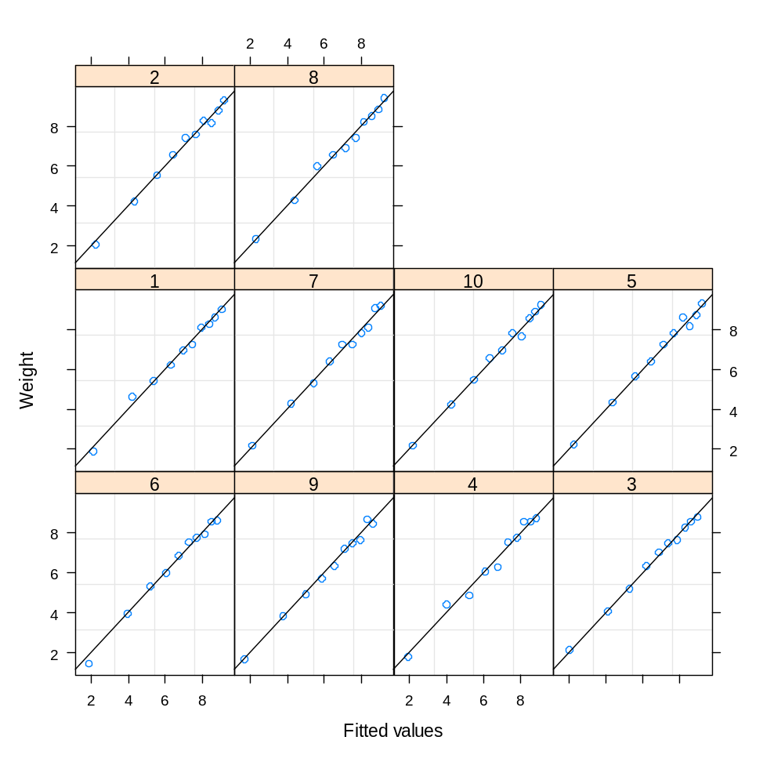
Fixed and Random Effects Together
(Length-weight regressions)
Always plot
your data!
Note the order in which the data are plotted

Slide 27
Fixed and Random Effects Together
(Length-weight regressions)
Linear mixed-effects model fit by REML
Data: LenW
AIC BIC logLik
6.72662 17.06649 0.63669
Random effects:
Formula: ~ 1 | Subject
(Intercept) Residual
StdDev: 0.2113517 0.205754
Fixed effects: Weight ~ Length
Value Std.Error DF t-value p-value
(Intercept) -0.026674 0.09560888 89 -0.2790 0.7809
Length 3.017151 0.02958709 89 101.9753 <.0001
Standardized Within-Group Residuals:
Min Q1 Med Q3 Max
-2.419116 -0.5799786 -0.05204277 0.5719096 2.320844
Number of Observations: 100
Number of Groups: 10

Slide 28
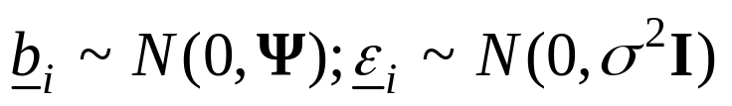

Theoretical Aspects-I
Vector of fixed effects
Vector of random effects
Observations for group i
This matrix will be a
function of parameters, Θ

Slide 29
Tricks and Traps
If you use REML estimation, you can only compare models with the same fixed-effects structure.
The standard output does not provide:
  the “best estimates” of the random effects - use coef(lmout) to find them.
  the confidence intervals for the variance parameters – use intervals(lmout, 0.95)

Slide 30
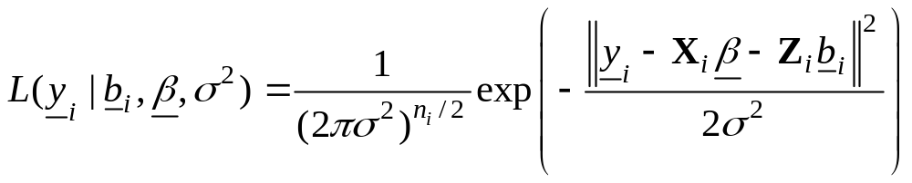
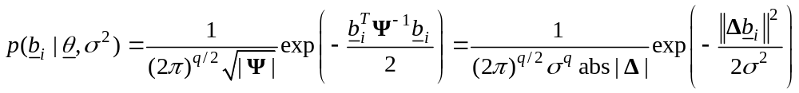
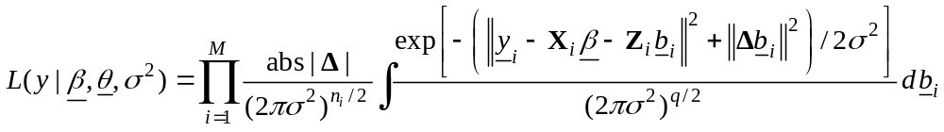
Theoretical Aspects-II

Slide 31
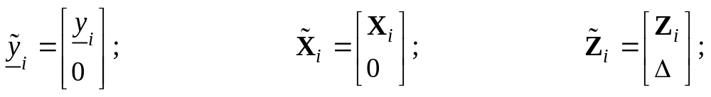
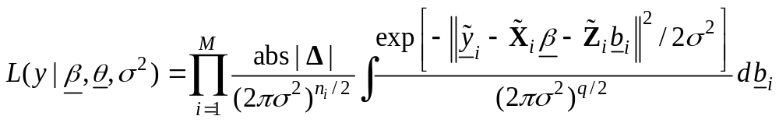
Theoretical Aspects-III
We now add the marginal distribution of the random effects
into extra rows.

Slide 32

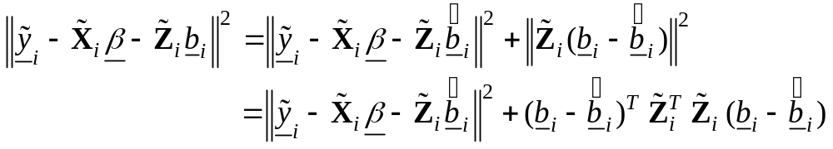
Theoretical Aspects-IV
We can determine the conditional modes of the random effects
given the data by minimizing the numerator.
Substituting back:

Slide 33
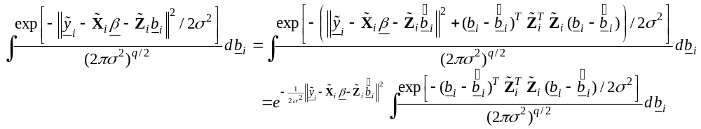
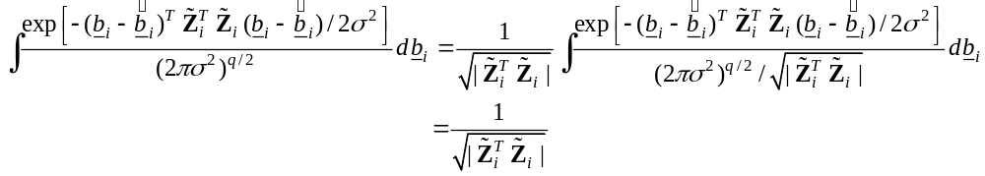
Theoretical Aspects-V
Now:

Slide 34
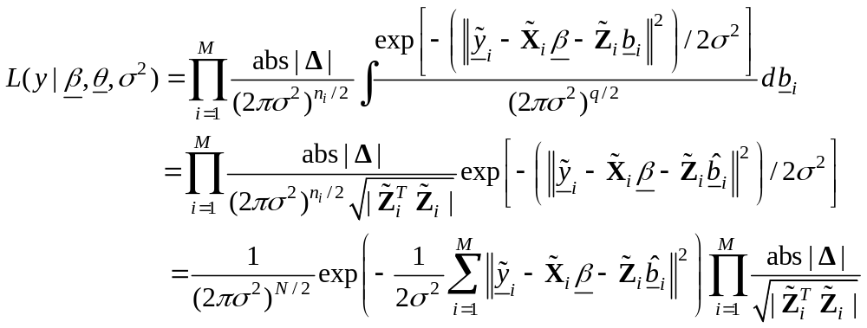
Theoretical Aspects-VI
Substituting back:

